Slide 1
Git Presentation TR Unconference 2022
Dan Jakob Ofer
@ofer987
https://github.com/ofer987
dan.ofer@thomsonreuters.com

Slide 2
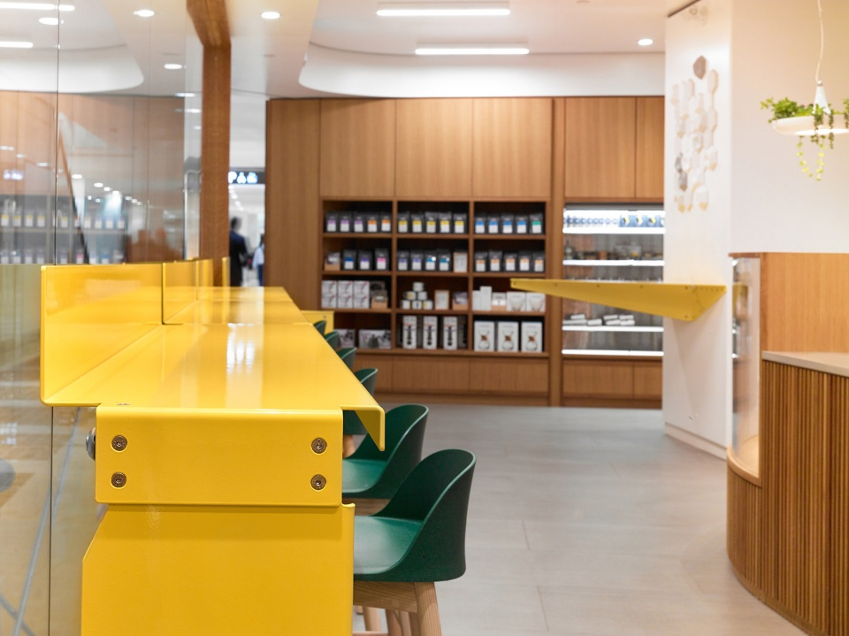
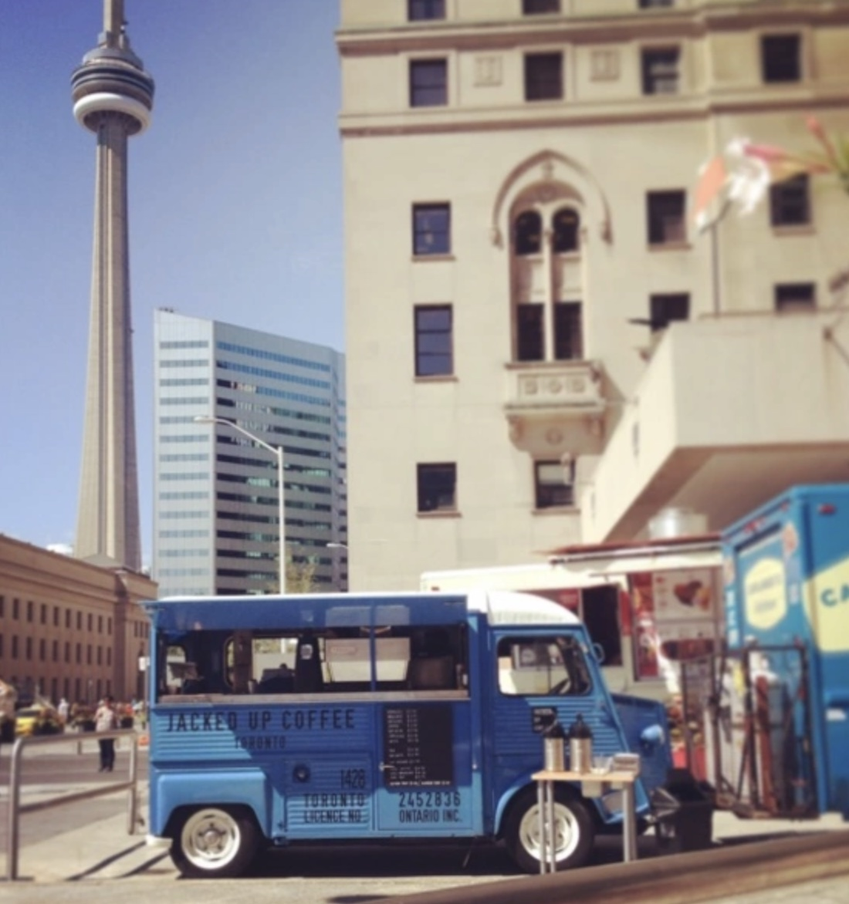
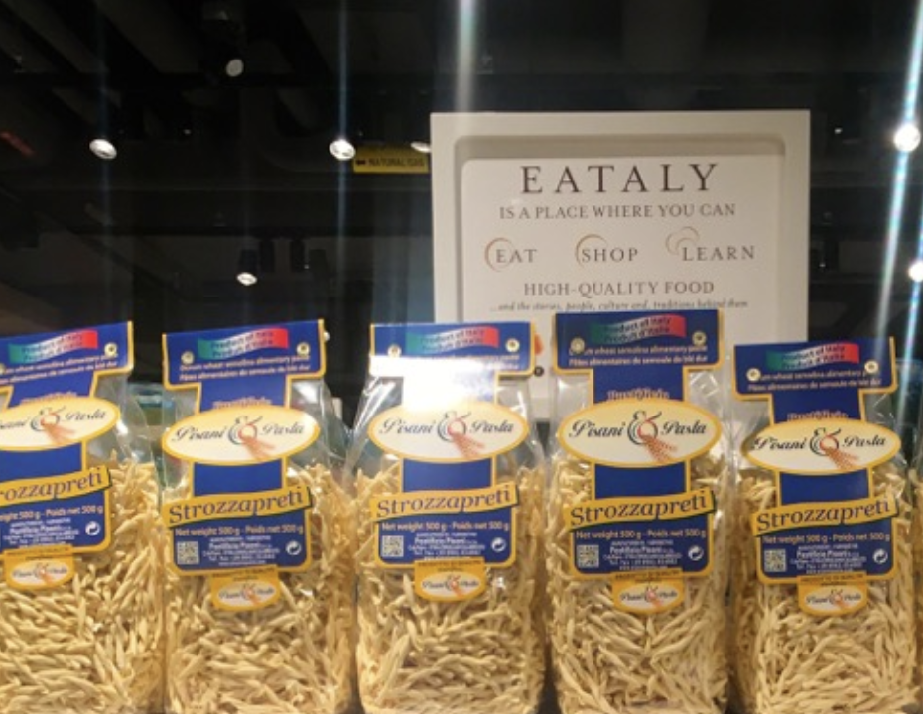
Yorkville
Pilot Coffee
Jacked Up Coffee
Eataly

Slide 3

Presentation
Understanding git source control management
Case study for facilitating deploying TR’s websites

Slide 4
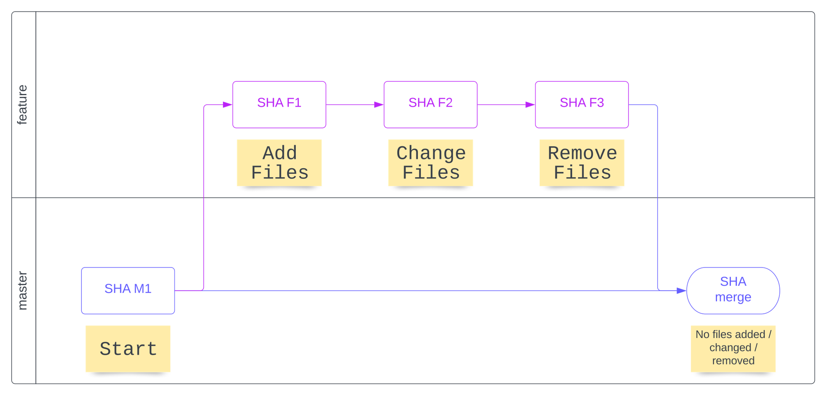
Overview

Slide 5
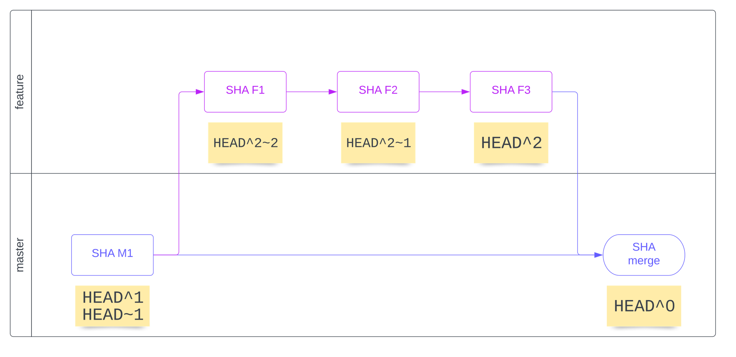
Commit references (absolute and relative)

Slide 6
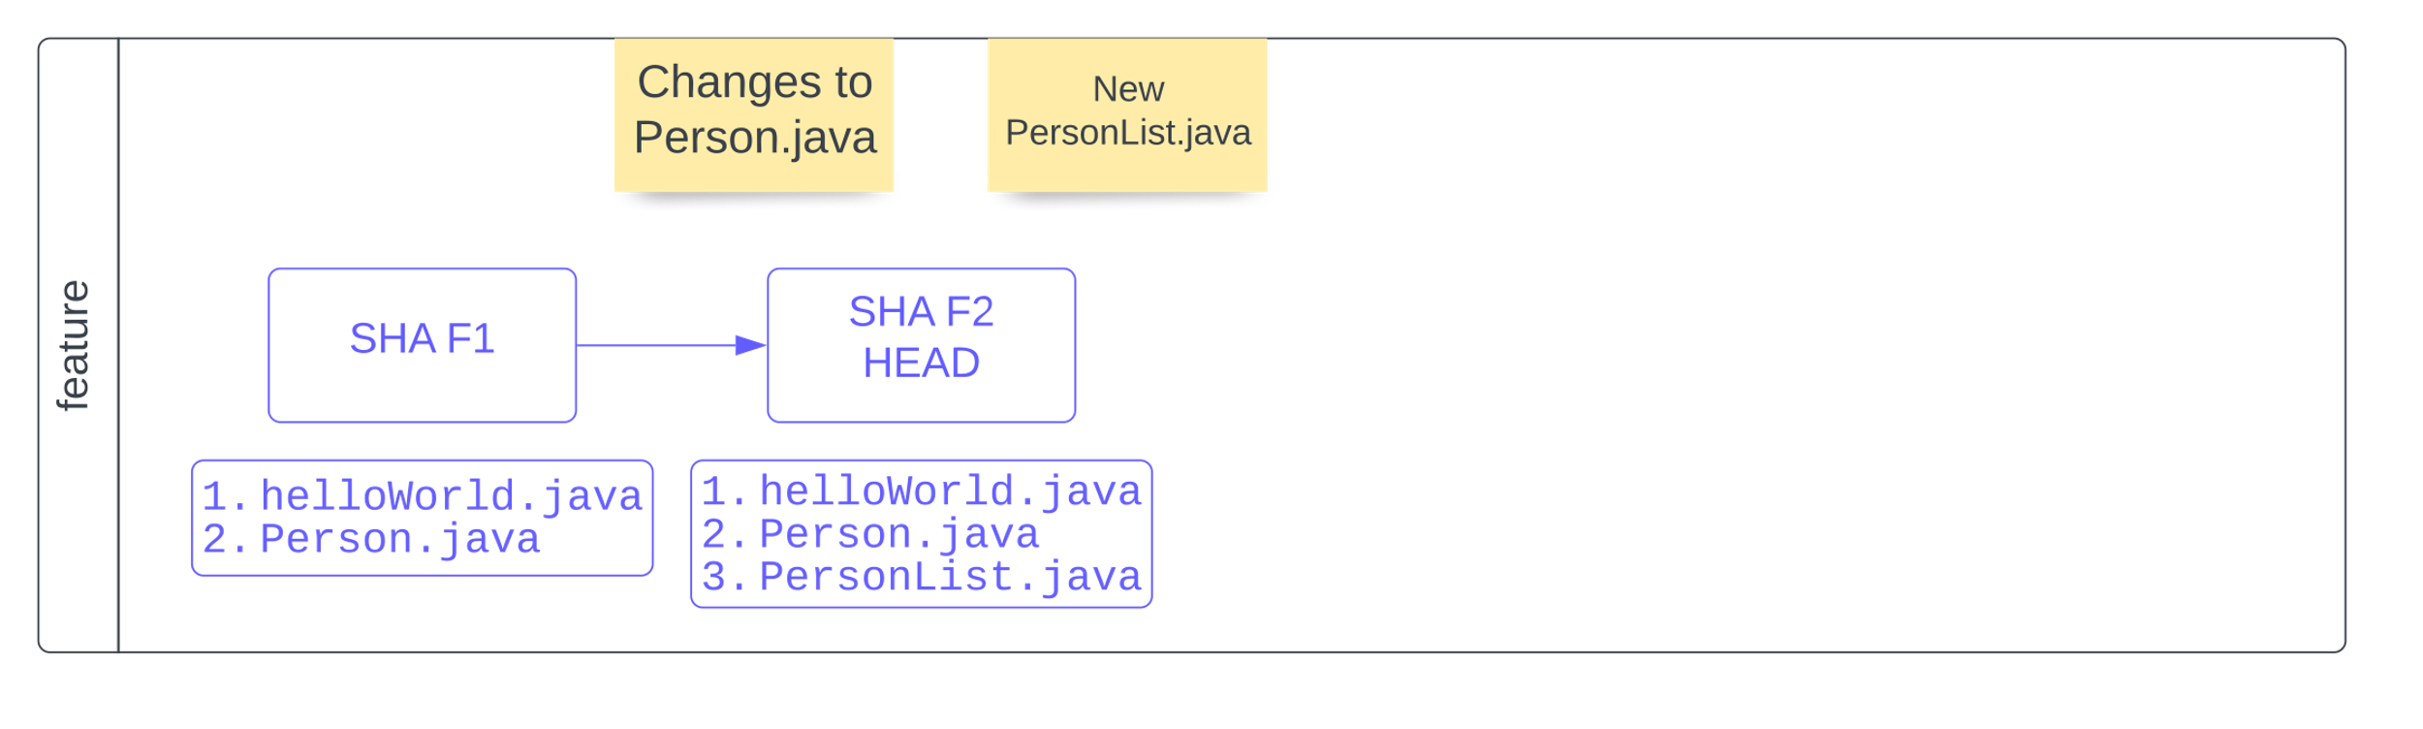
Fix commit history (part 1)

Slide 7
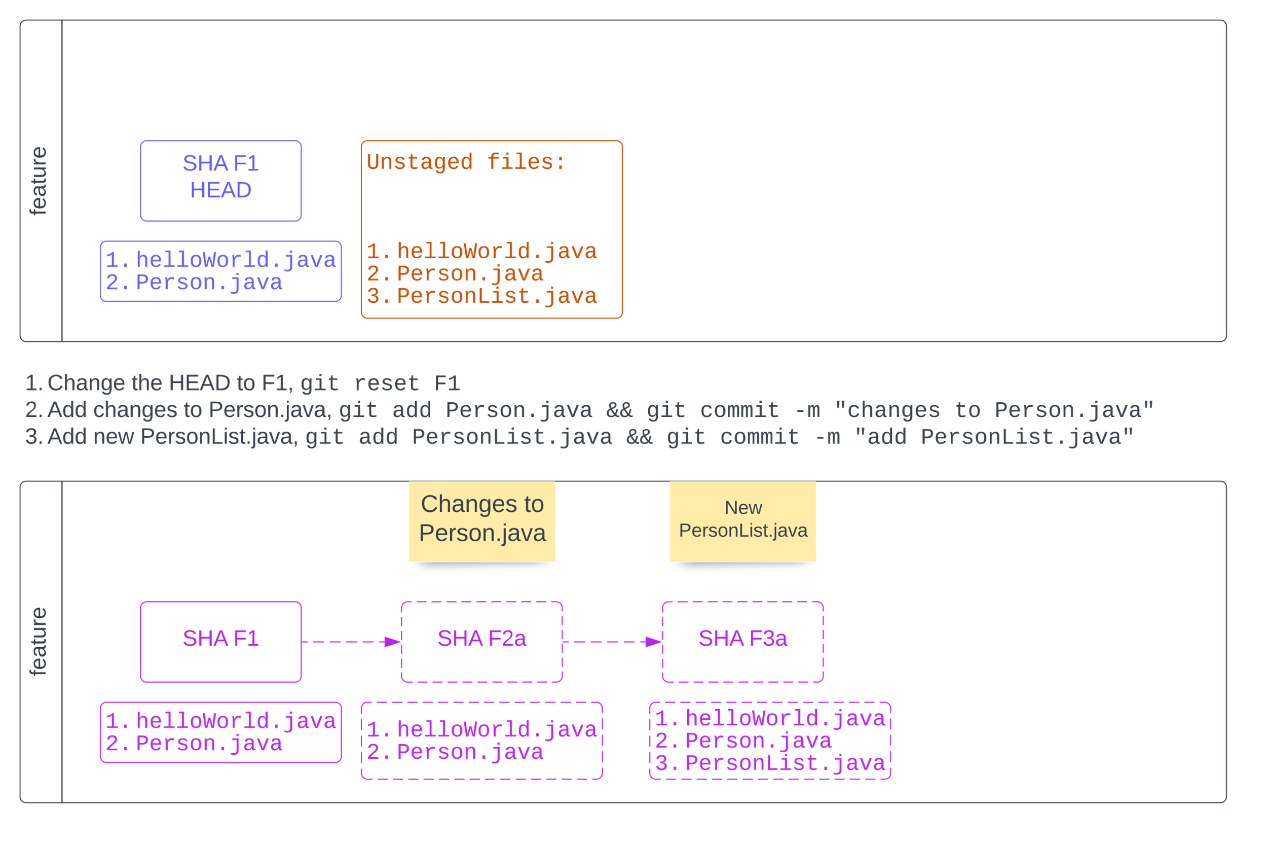
Fix commit history (part 2)

Slide 8
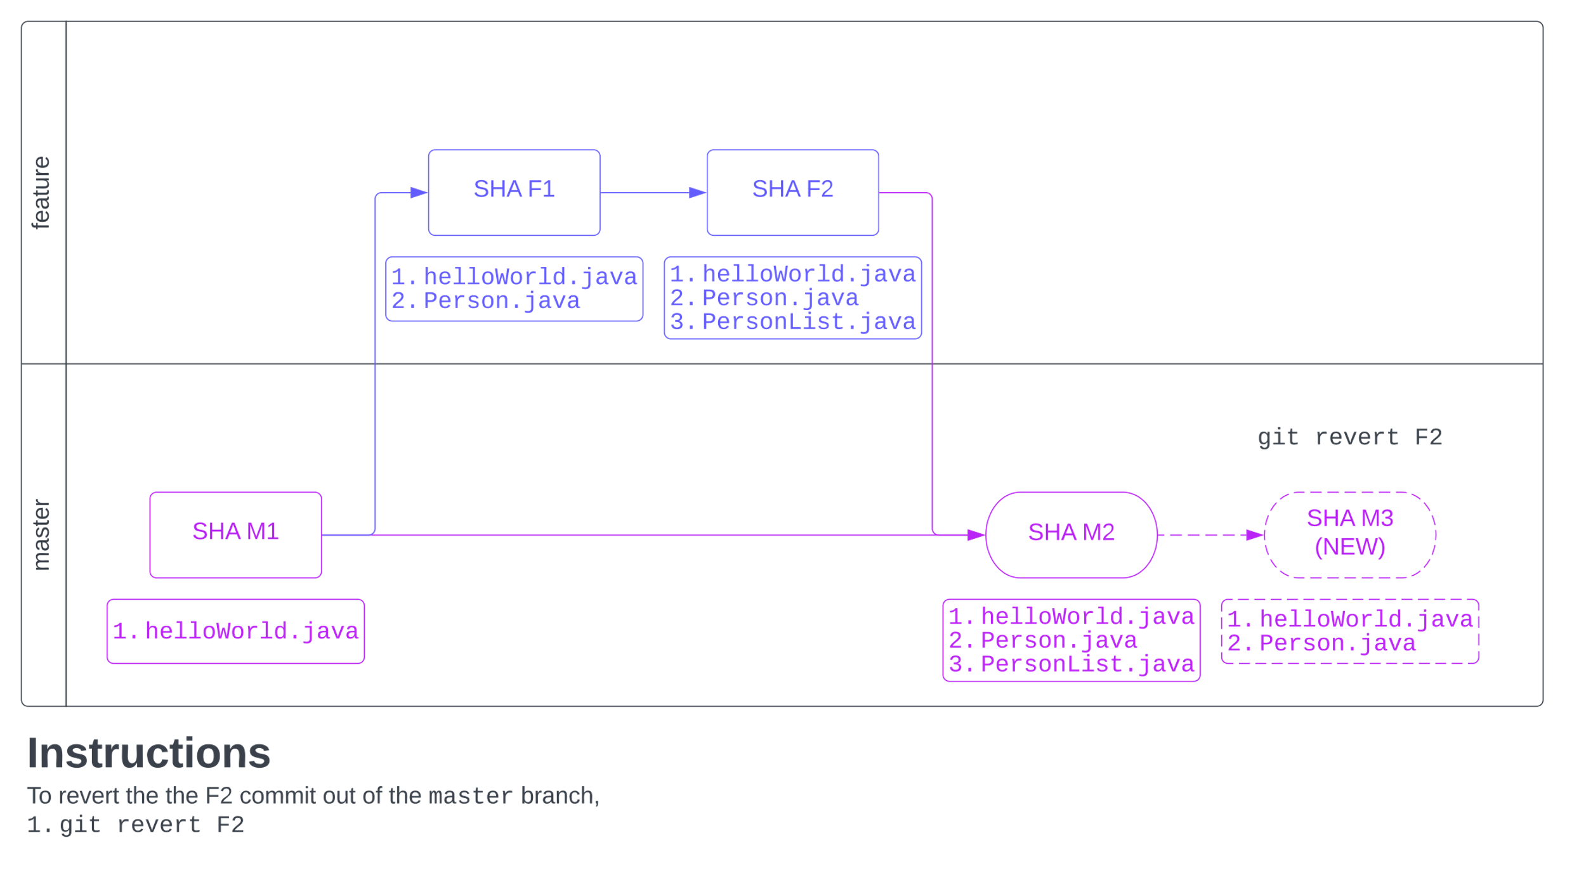
Revert a commit

Slide 9
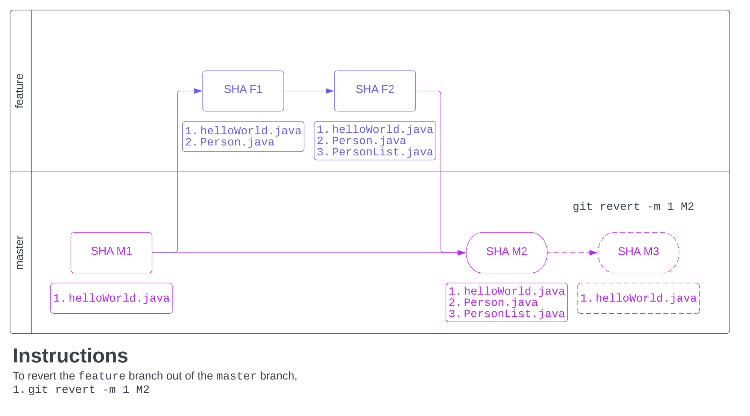
Revert a merge commit (e.g., a Pull Request)

Slide 10
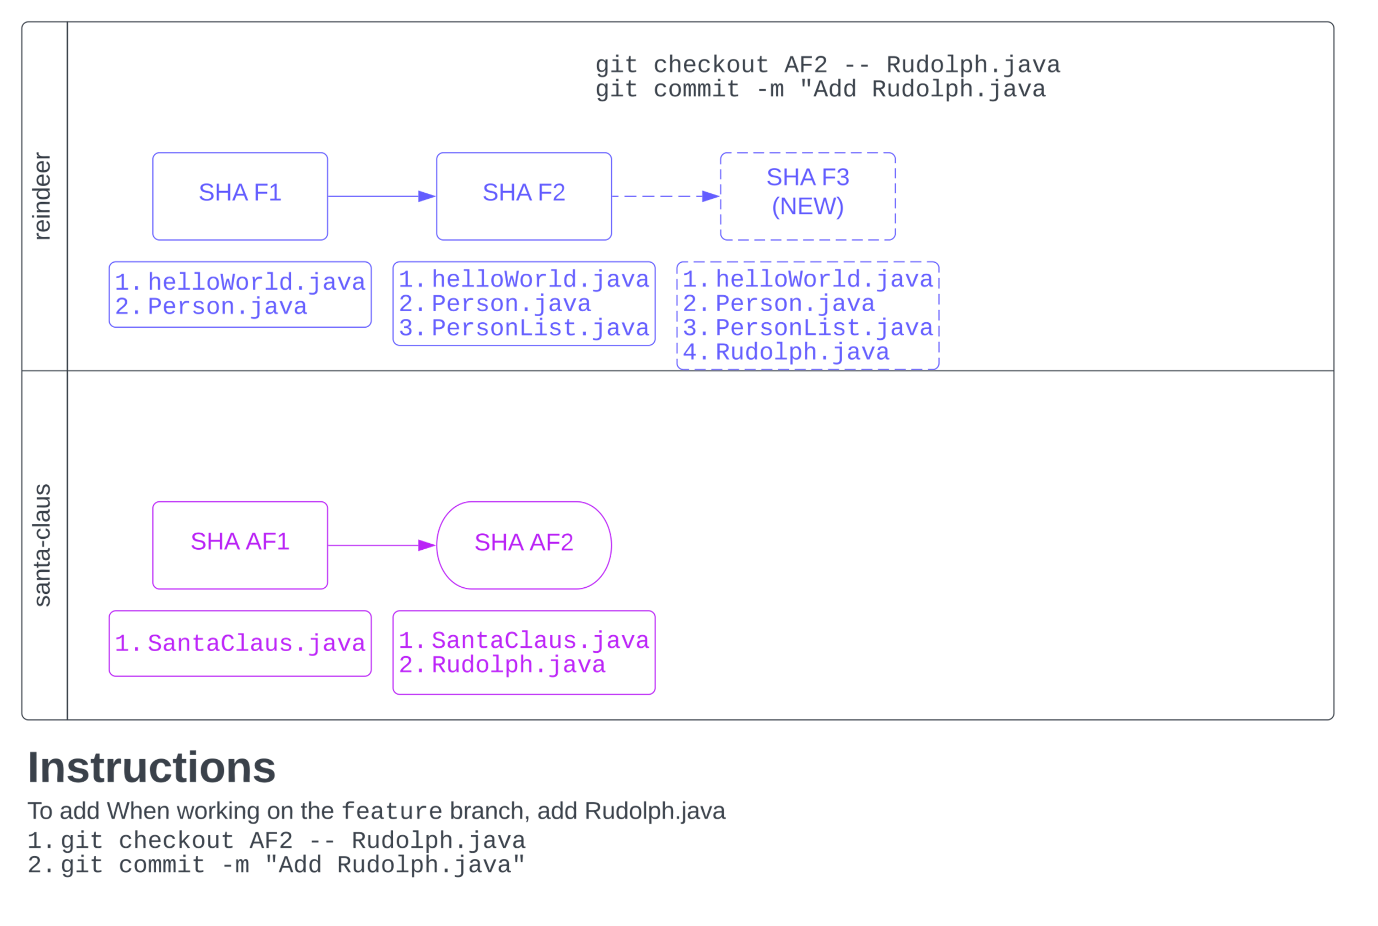
Checkout files from commit

Slide 11
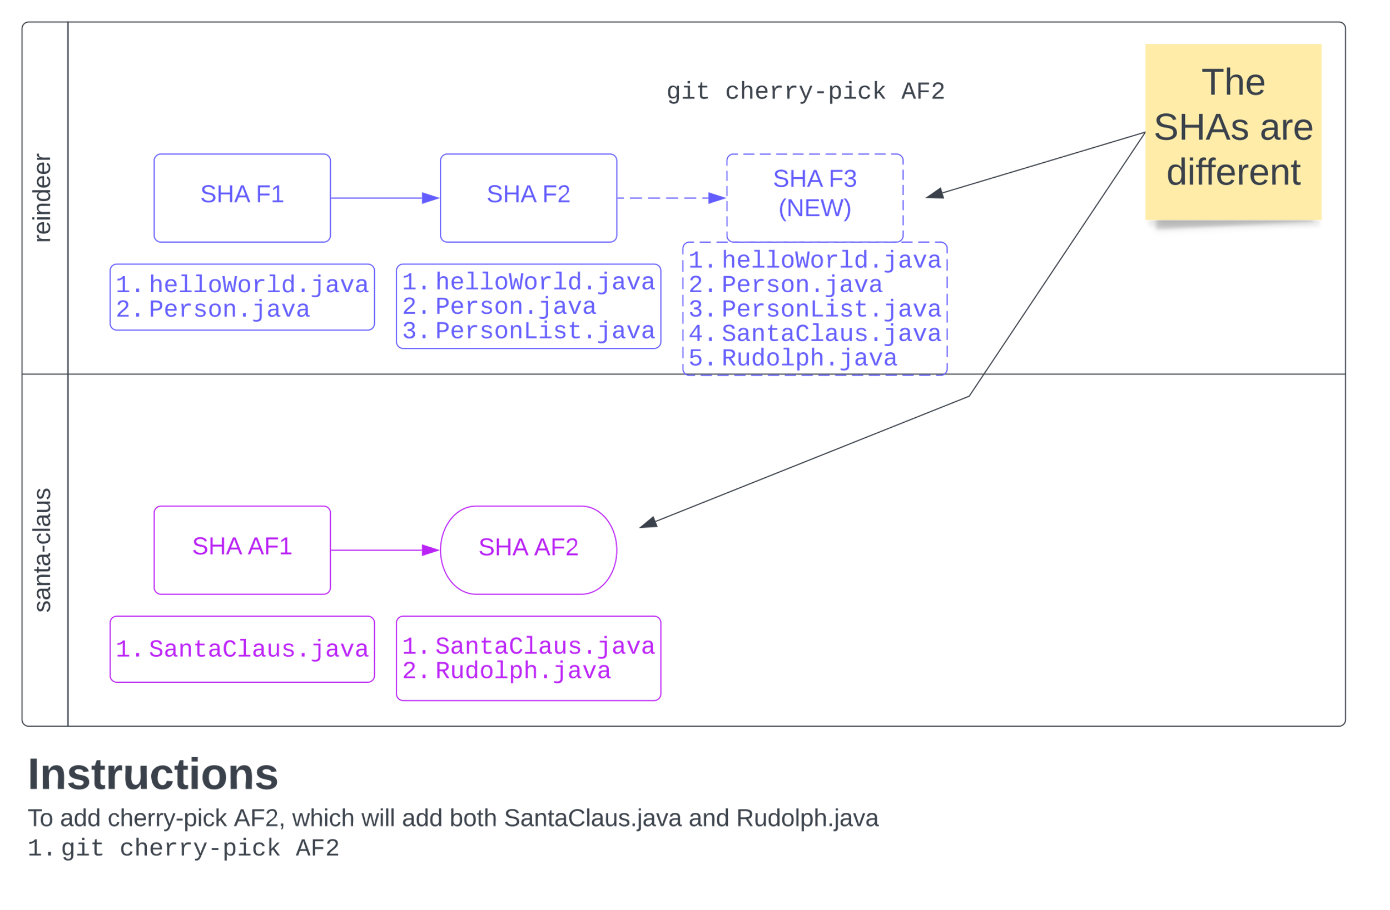
Cherry-pick commit from another branch

Slide 12
Mission: Improve release process!
Who am I?
I work on the Digital Team
Responsible for improving our release processes
Problems we are facing
Several server environments
Hundreds of developers
Two-week Sprints
Four weeks between End-of-sprint to Production Release

Slide 13
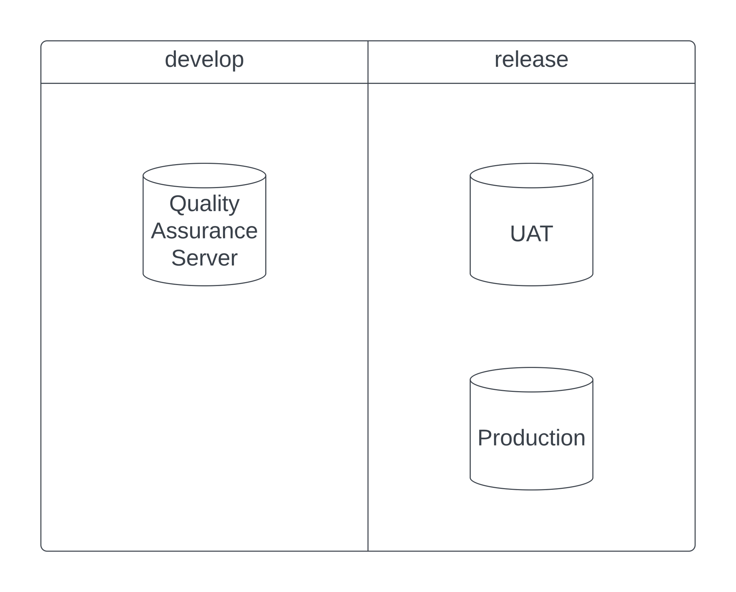
Server Environments

Slide 14
Development and Release History
Year | Developers | Location | Release Process | Notes
2018 | 3 | All in London, UK | Legacy Process | Manual Deployments ☹
2019 | 10 | All in Toronto, Canada |  | Talk between developers
2020 | > 10, but < 100 | Worldwide, e.g., Toronto, United States, Eastern Europe, India |  | Problems arise!
2021 | > 100 | Worldwide, e.g., Toronto, United States, Eastern Europe, India | Release Process 1.0 | But it is confusing!
2022 (>= Sept) | > 200 | Worldwide, e.g., Toronto, United States, Eastern Europe, India | Release Process 2.0 | 1. Simpler 2. Facilitates deployment 3. Easier to communicate

Slide 15
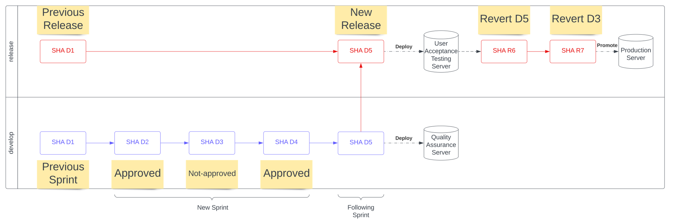
Release Process 1.0

Slide 16
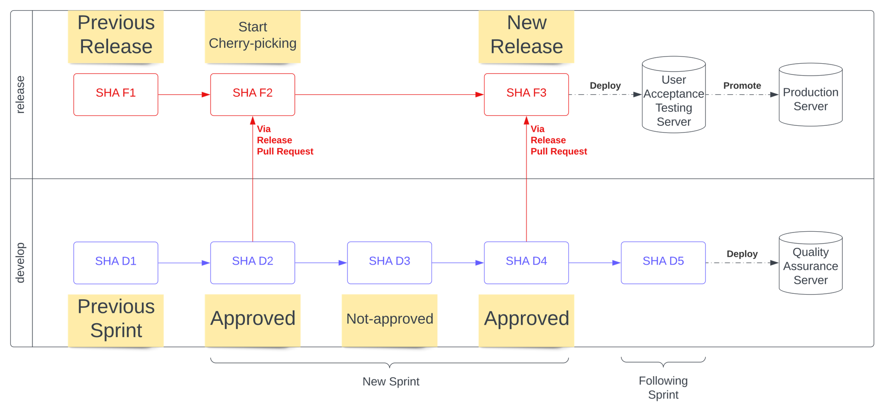
Release Process 2.0

Slide 17
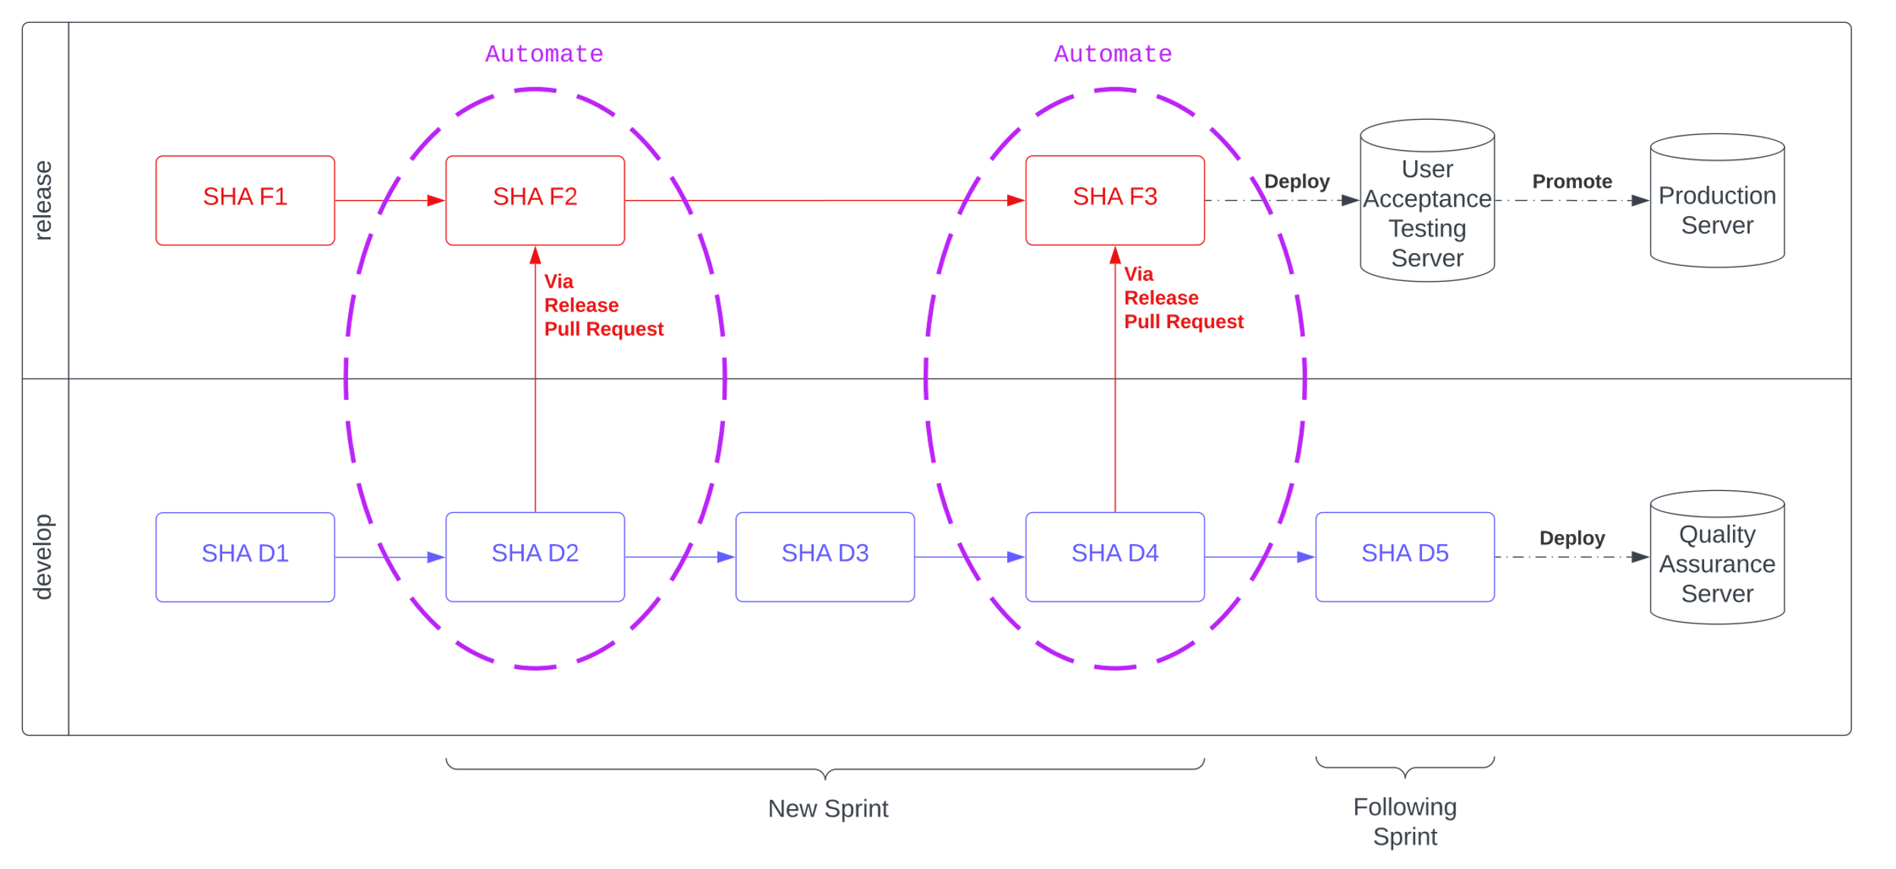
Automate the process!

Slide 18
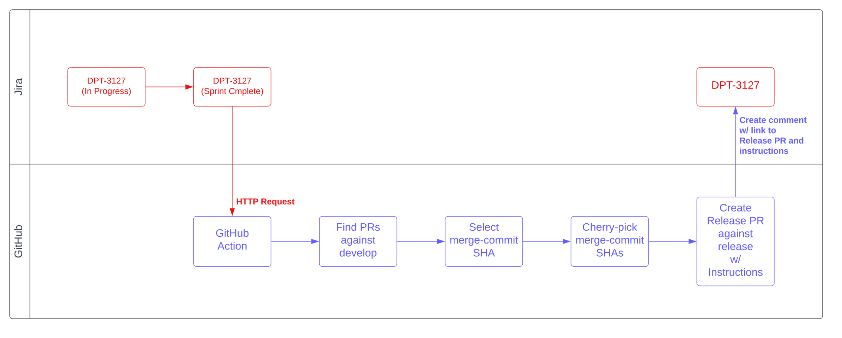
Flow between Jira and GitHub

Slide 19
Current release process
Deploy everything in the develop branch
Revert unapproved Jira Issues
Sometimes we deploy work-in-progress code our code from next Sprint, and we find out in Production

Slide 20
What is a Release Pull Request?
A Release Pull Request is an Approved Jira Issue’s commits amalgamated into a new Pull Request against Production’s branch, release.
Release Pull Requests ensure that only approved code is delivered to the Production server.

Slide 21
Moving code from QA to Production
Jira Issue’s state is moved from Validated to Sprint Complete
Jira Server sends HTTP Request to GitHub Action
GitHub Action intelligently finds associated Pull Requests
Creates Release Pull Request to deliver to Production
All actions, including commands, printed to both the Jira Issue and Release Pull Request
In case of merge conflicts, the developer can repair the Pull Request, using the printed commands!

Slide 22
Automate a Cherry-picking Pull Request
Create local Cherry-pick branch, releases/<jira-key>
Checkout Cherry-pick branch, releases/<jira-key>
Add empty commit (to ensure that Pull Request can be created)
Cherry-pick merge commit SHAs of associated Pull Requests
Push branch to GitHub
Open Pull Request in GitHub
All actions (including git CLI commands) printed in,
Pull Request’s body
Jira Issue comment

